Slide 1
Analysis of Sales Dataset
Grace Imanuela Ruttun Karoma’

Slide 2
Analysis Background
The dataset is from Kaggle.com.
There is a sales dataset table with 8 columns, there are:
Unnamed: 0 = Auto index
Date = The date the transaction occurred
Gender = The gender of the customers
Age = The age of the customers
Product Category = The category of the products
Quantity = The number of products purchased
Price per unit = Price of the single products
Total Amount = Total sales of the products (quantity x price per unit)
There are 1000 rows and 8 columns

Slide 3
Dataset
The dataset is from Kaggle.com.
There is a sales dataset table with 8 columns, there are:
Unnamed: 0 = Auto index
Date = The date the transaction occurred
Gender = The gender of the customers
Age = The age of the customers
Product Category = The category of the products
Quantity = The number of products purchased
Price per unit = Price of the single products
Total Amount = Total sales of the products (quantity x price per unit)
There are 1000 rows and 8 columns

Slide 4
Dataset
Dataset table preview

Slide 5
Tools

Slide 6
Data Exploration
Data Anomalies

Slide 7
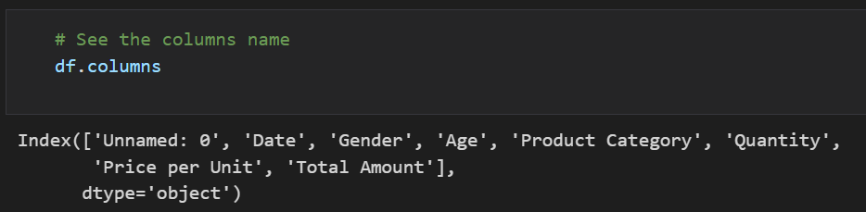
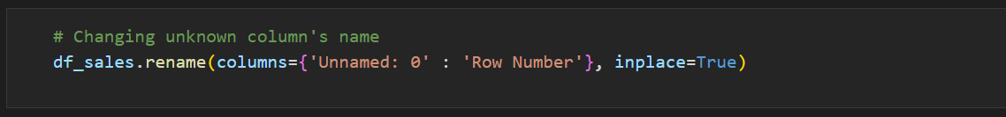
Column Names
There are 8 columns in this table. And there is one column that has an unnamed name.
That is why the unnamed column name changed to the “Row Number” column.

Slide 8
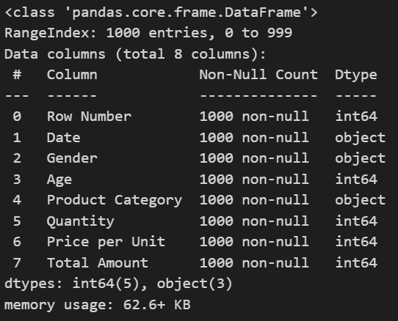
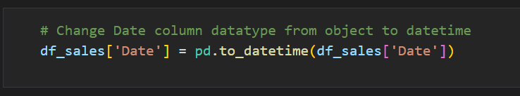
Column Datatypes
The 8 columns of data types have one column with incorrect datatypes.
The column with incorrect datatypes is the Date column. The datatype should be a datetime datatype.

Slide 9
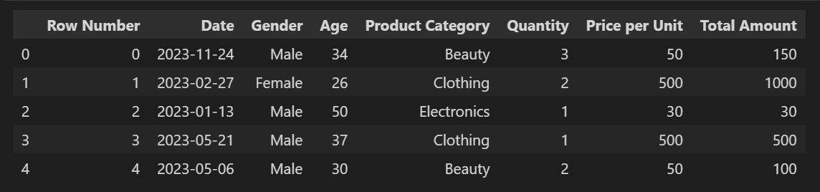
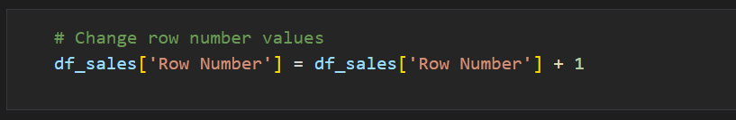
Column Values
The Row Number column values start with 0. Because there are 1000 rows, the last row number will be 999.
Instead of starting with 0 and ending with 999. It will be better if the row number starts with 1 and ends with 1000

Slide 10
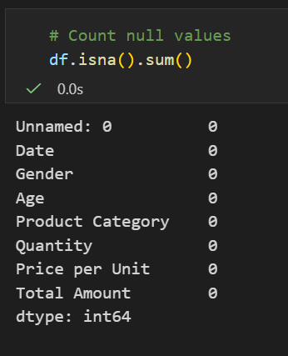
Null Values
The Row Number column values start with 0. Because there are 1000 rows, the last row number will be 999.

Slide 11
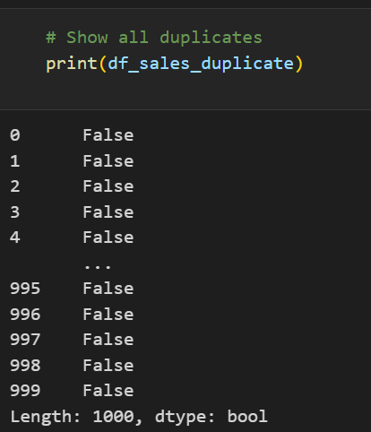
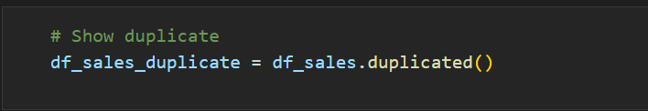
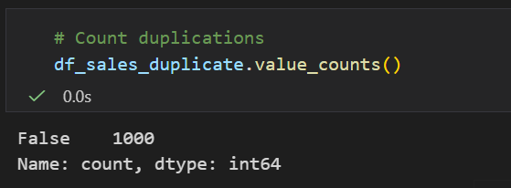
Data Duplication
The duplication can occur for many reasons, like human error, system integration issues, data entry variations, merging data from many sources, etc.
Instead of dropping the duplicates immediately, it is better to show the duplicates to know the reason for the duplicates.

Slide 12
Data Anomalies Conclusions
The unnamed column changed to the Row Number column
The date datatype from the object datatype changed to the datetime datatype
The row number starting with 0 and ending with 999 changed to 1 to 1000
There are no null values
ds

Slide 13
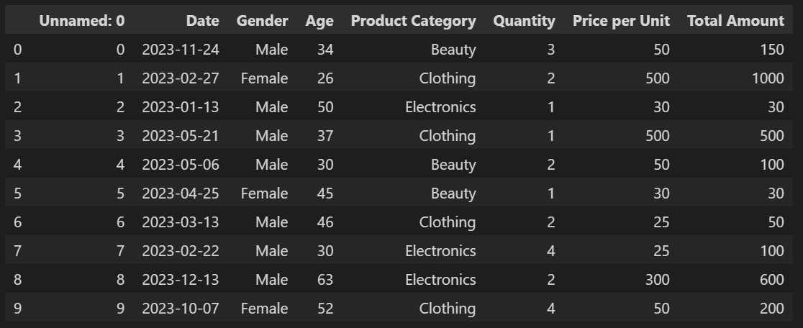
Data Anomalies Conclusions
The duplication can occur for many reasons, like human error, system integration issues, data entry variations, merging data from many sources, etc.

Slide 14
Summary
The dataset is from Kaggle.com.
There is a sales dataset table with 8 columns, there are:
Unnamed: 0 = Auto index
Date = The date the transaction occurred
Gender = The gender of the customers
Age = The age of the customers
Product Category = The category of the products
Quantity = The number of products purchased
Price per unit = Price of the single products
Total Amount = Total sales of the products (quantity x price per unit)
There are 1000 rows and 8 columns

